Slide 1
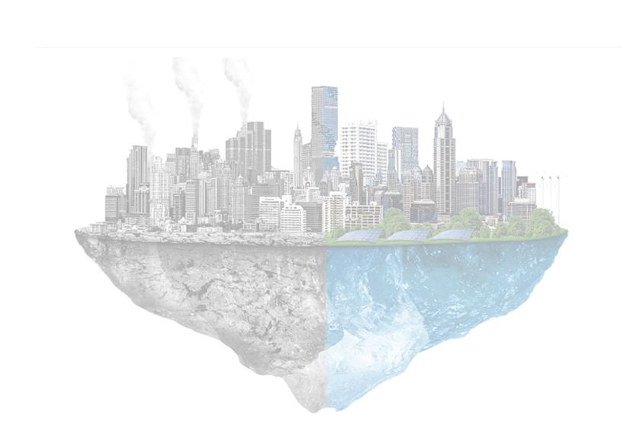
PPOL 564
Project presented by Harshini

Slide 2
Background
It is expected that 68% of the world’s population will live in cities by 2050 and even now it is 55%.Hence ensuring that cities are sustainable and eco-friendly is critical.Many cities around the world have already begun to adopt sustainable practices and many more will follow the path in future.In this backdrop, my project focuses on which city stands where and what are the various factors that influence the sustainability of a city.

Slide 3
Problem Statement
The first part of my project focuses on creating a composite sustainability variable to measure and rank various cities across the world. For this I chose 8 Sustainability parameters on which a city will be measured and a composite variable will be created.

Slide 4
Problem Statement
After defining the sustainability variable, cities will be ranked based on this. Finally, I would study various independent variables that could possibly influence the sustainability of cities and correlation between them using OLS.

Slide 5
Methods/Approaches considered
Joining dataframes, Groupby, Web scrapping, Data visualization using rapidminer. For Modelling – OLS;

Slide 6
Methods & Tools Applied
Handling missing values. Splitting and Merging data frames, Groupby, Web scrapping, Data visualization using bar charts.

Slide 7
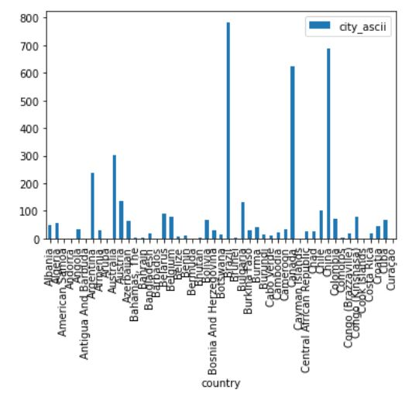
Preliminary results-City data

Slide 8
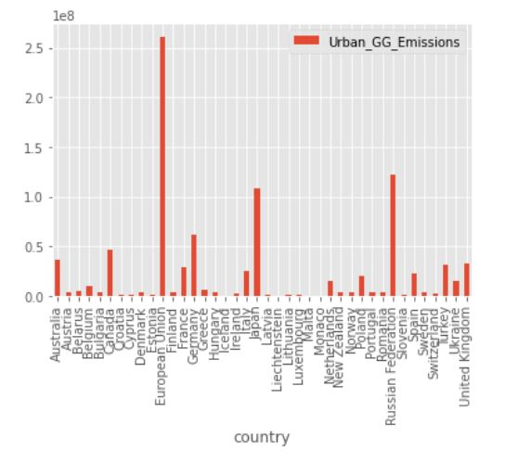
Preliminary results-SP1 data

Slide 9
Conclusion-Challenges
Datasets have a lot of missing values ! I am still figuring out on how I will be able to pull enough data with all the Sustainability parameters covered. Most of the data is available at country level, Though I have used some standards to bring it to city level, I am worried this might influence the results. Modelling – Wondering which machine learning technique works best for this!

Slide 10
Conclusion
Further action :Data visualizations and processing for the rest of the Sustainability parameters. Statistical analysis of the parameter with independent variables.

Slide 11
THANK YOU

